Slide 1
E-commerce Business Models and Concepts
Rehema Baguma, PhD

Slide 2
Discussion Questions
What is a business Model/strategy?
What are the elements of a business model/strategy?
What are the common B2C and B2B models

Slide 3
E-commerce Business Models
Business model
  Set of planned activities designed to result in a profit in a marketplace
Business plan
  Describes a firm’s business model
E-commerce business model
  Uses/leverages unique qualities of Internet and Web

Slide 4
8 Key Elements of a Business Model
Value proposition
Revenue model
Market opportunity
Competitive environment
Competitive advantage
Market strategy
Organizational Development
Management team

Slide 5
1. Value Proposition
Why should the customer buy from you?
Successful e-commerce value propositions:
  Personalization/customization
  Reduction of product search, price discovery costs
  Facilitation of transactions by managing product delivery
Example: Amazon

Slide 6
2. Revenue Model
How will the firm earn revenue, generate profits, and produce a superior return on invested capital?
Major types:
  Advertising revenue model
  Subscription revenue model
  Transaction fee revenue model
  Sales revenue model
  Affiliate revenue model

Slide 7
Advertising Revenue Model
Offers its users content, services, and/or products.
Provides a forum for advertisements and receives fees from advertisers.
Highly specialized, differentiated viewership and are able to retain user attention (“stickiness”) are able to charge higher advertising rates.
Yahoo - display and video advertising.
Notes:
What is stickness as used in e-commerce revenue models?

Slide 8
Subscription Revenue Model
Web site that offers its users content or services charges a subscription fee for access to some or all of its offerings.
Example: Consumer Reports, Rupert Murdoch owned papers (WSJ), newvision’s e-paper, high quality research papers, etc
Content offered must be perceived as a high-value-added, premium offering that is not readily available elsewhere nor easily replicated

Slide 9
Sales Revenue Model
Companies derive revenue by selling goods, information, or services to customers.
Companies such as Amazon (which sells books, music, and other products, jumia.com.
Example: Amazon, Gap

Slide 10
Affiliate Revenue Model
Sites that steer business to an “affiliate” receive a referral fee or percentage of the revenue from any resulting sales.
Example: MyPoints, Epinions.

Slide 11
Transaction Fee Revenue Model
A company receives a fee for enabling or executing a transaction.
Example: Ebay receives a small transaction fee from a seller if the seller is successful in selling the item.
E*Trade, an online stockbroker, receives transaction fees each time it executes a stock transaction on behalf of a customer.
Other examples are; jumia.com, HelloFood.com etc

Slide 12
3. Market Opportunity
What marketspace do you intend to serve and what is its size?
  Marketspace: Area of actual or potential commercial value in which company intends to operate
  Realistic market opportunity: Defined by revenue potential in each market niche in which company hopes to compete
Market opportunity typically divided into smaller niches

Slide 13
4. Competitive Environment
Who else occupies your intended market space?
  Other companies selling similar products in the same marketspace
  Includes both
    direct
    indirect competitors
Influenced by:
  Number and size of active competitors
  Each competitor’s market share
  Competitors’ profitability
  Competitors’ pricing

Slide 14
5. Competitive Advantage
Achieved when firm:
  Produces superior product or
  Can bring product to market at lower price than competitors
Important concepts:
  Asymmetries – Apple (iTunes)
  First-mover advantage - Amazon
  Unfair competitive advantage – Brand Names e.g. sony Vs other TV brands, Amazon Vs other e-book stores, etc
  Leverage – Amazon’s entry into Grocery
Notes:
Which of the following factors can determine a firm’s competitive advantage?

Slide 15
6. Market Strategy
How do you plan to promote your products or services to attract your target audience?
  Details how a company intends to enter market and attract customers
  Best business concepts will fail if not properly marketed to potential customers
Examples: Twitter, YouTube, and Photobucket
Slide 2-<number>
Notes:
Identify a product or service that can be better either partially or wholly sold electronically and develop a business model for it. Your model should include the following components; marketing strategy, OD, management team, competitive advantage, revenue model, value proposition, market opportunity, competitive environment

Slide 16
7. Organizational Development
What types of organizational structures within the firm are necessary to carry out the business plan?
Describes how firm will organize work
  Typically divided into functional departments
  As company grows, hiring moves from generalists to specialists

Slide 17
8. Management Team
What kinds of experiences and background are important for the company’s leaders to have?
  Employees are responsible for making the business model work
  Strong management team gives instant credibility to outside investors
  Strong management team may not be able to salvage a weak business model, but should be able to change the model and redefine the business as it becomes necessary
Notes:
What is the relationship between a management team and an e-commerce business model?

Slide 18
Summary of a Business Model
Business Model
Components
Key Questions
Value Proposition
Why should the customer buy from you?
Revenue model
How will you earn money?
Market opportunity
What market space do you intend to serve, and what is its size?
Competitive environment
Who else occupies your intended marketspace?
Competitive advantage
What special advantages does your firm bring to the marketspace?
Market strategy
How do you plan to promote your products to attract customer?
Organizational
development
What types of organizational structures within the firm are
necessary to carry out the business plan?
Management team
What kinds of experiences and background are important for
the company’s leaders to have?

Slide 19
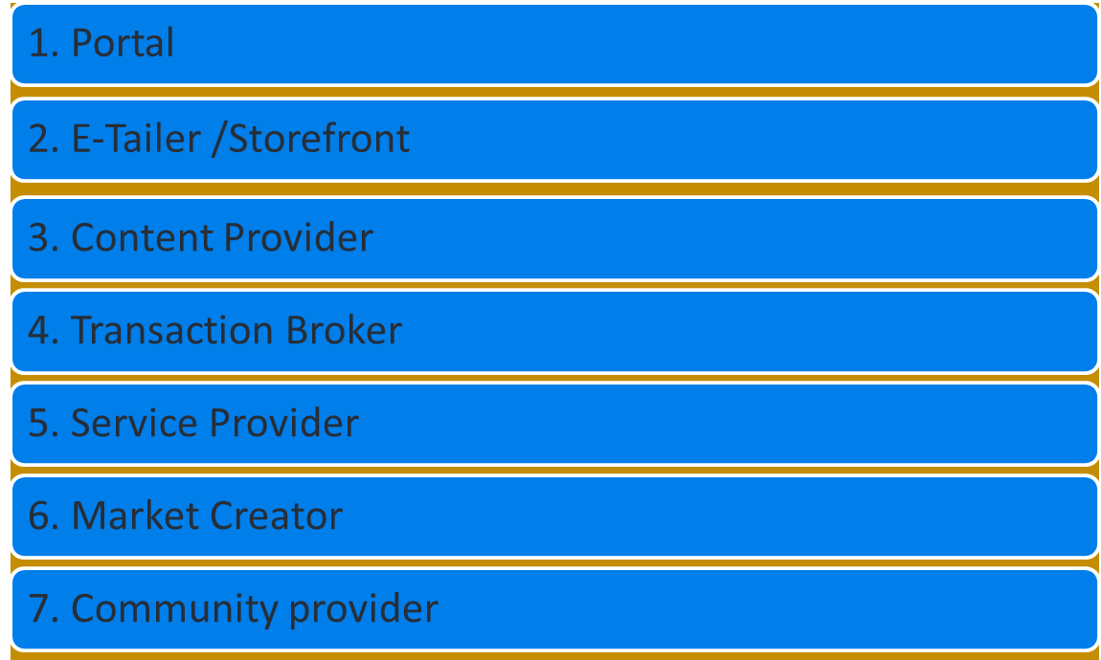
Major Business-to-Consumer (B2C) Models

Slide 20
Major B2C Business Models
Business Model | Variation | Example | Description
Portal | Overview |  | Portals are “gateways” to the Internet Offers powerful Web searching tools-effiency and ease The portal business model is in addition to serving as a gateway to the Internet; It is a destination site provide an integrated package of content and services all in one place e.g. news, weather forecasts, forex rates, etc

Slide 21
Business Model | Variation | Example | Description
Portal | Horizontal/ General | Yahoo.com msn.com | Offers an integrated package of services and content such as search,e-mail,chat etc. Seeks to be a user’s home base.
 | Vertical/ Specialized | iBoats.com | Offers services and products to specialized marketplace. A gateway or portal to information related to a particular industry, such as human resources, health care, insurance, automobiles, or food manufacturing. Portals are also seen as likely business-to-business communities

Slide 22
Business Model | Variation | Example | Description
E-tailer/ Storefront | Virtual merchant | Amazon.com, ebooks.com | Online version of retail store where customers can shop 24/7 with comfort.
 | Click and mortar | Walmart.com, bestbuy.com | Online distributor channel for company that also has physical stores.
 | Catalog merchant | LandsEnd.com, llbean.com | Online version of direct catalog. The catalog merchant has generally lower prices than other retailers and lower overhead expenses due to the smaller size of store and lack of large showroom space.
 | Online mall | Fashionmall.com internetmall.com | Online version of mall.
 | Manufacturer direct | Dell.com, unionway.com | Online sales made directly by manufacturers.

Slide 23
Major B2C Business Models
Business Model | Variation | Example | Description
Content Provider |  | Sportsline.com, CNN.com, deviantart.com | Information and entertainment providers like newspapers, sports sites or other online sources offering up-to-date information (news, special interest , photos, video, artwork etc) to customers. Infomediaries: electronic intermediaries that control information flow in cyberspace, often aggregating information and selling it to others They do not own but aggregate and distribute the content produced by others

Slide 24
Business Model | Variation | Example | Description
SERVICE PROVIDER |  | xDrive.com, Whatsitworth toyou.com | Companies that make money by selling users a service, rather than a product. Offers services online, like consultancy, trade knowledge, expertise, data analysis, data storage, etc.

Slide 25
Major B2C Business Models
Business Model | Variation | Example | Description
Transaction broker |  | E-Trade.com, Monster.com Jumia.com HelloFood | Processors of online sales transactions, such as stock brokers and travel agents that increase customer `s productivity by helping them do things faster. It assists buyers, sellers, or both during transaction and acts as an agent for larger markets. Furthermore, they sell other’s products rather than their own product. Transaction brokers receive commissions for every transaction that had been successfully concluded in order to sustain their business. One legal advantage to sellers is that the seller is usually not legally responsible for the actions of transaction brokers acting within the scope of the transaction.

Slide 26
Business Model | Variation | Example | Description
Community Provider |  | About.com, iVillage.com, facebook, twitter, linkedin, etc | Sites where individuals with particular interests, hobbies and common experience can come together and compare. Communities utilize electronic tools such as forums, chat rooms, e-mail lists, message boards, and other interactive Internet mechanisms, which are usually tailored to the particular community.
Provide online environment (social network) where people with similar interests can transact, share content, and communicate
  E.g. Facebook, MySpace, LinkedIn, Twitter, iVillage, Babystyle-Huggies

Slide 27
B2C Models: Market Creator
Create digital environment where buyers and sellers can meet and transact
Examples:
  Priceline
  eBay
  OLX
Revenue model: Transaction fees

Slide 28
B2C Models: Service Provider
Online services
  e.g. Google: Google Maps, Gmail, etc.
Value proposition
  Valuable, convenient, time-saving, low-cost alternatives to traditional service providers
Revenue models:
  Sales of services, subscription fees, advertising, sales of marketing data

Slide 29
B2B Business Models
Net marketplaces
  E-distributor
  E-procurement
  Exchange
  Industry consortium
Private industrial network
  Single firm
  Industry-wide

Slide 30
B2B Models: E-distributor
Version of retail and wholesale store, MRO goods and indirect goods
Owned by one company seeking to serve many customers
Revenue model: Sales of goods
Example: Grainger.com

Slide 31
B2B Models: E-procurement
Creates digital markets where participants transact for indirect goods
Revenue model:
  Service fees, supply-chain management, fulfillment services
Example: Ariba

Slide 32
B2B Models: Exchanges/vertical e-mkts
Independently owned vertical digital marketplace for direct inputs
Revenue model: Transaction, commission fees
Create powerful competition between suppliers
Tend to force suppliers into powerful price competition; number of exchanges has dropped dramatically
2002- 1500 Exchanges
2010- less than 200 Exchanges

Slide 33
B2B Models: Industry Consortia
Industry-owned vertical digital marketplace open to select suppliers
More successful than exchanges
  Sponsored by powerful industry players
  Strengthen traditional purchasing behavior
Revenue model: Transaction, commission fees
Example: Exostar - Aerospace and Defense industry

Slide 34
Other E-commerce Business Models
Consumer-to-consumer (C2C)
  eBay, Craigslist, Half.com, OLX
Peer-to-peer (P2P)
M-commerce:
  Prior to 2009, mobile commerce in the United States had been a disappointment.
  Technology platform continues to evolve
  iPhone, smartphones energizing interest in m-commerce apps
  Paypal Mobile, EBay Mobile, hellofood App

Slide 35
E-commerce Enablers: The Gold Rush Model
E-commerce infrastructure companies have profited the most:
  Hardware – Web Servers - IBM, HP, Dell, Oracle
  Software - Operating Systems and Server Software - Microsoft, RedHat Linux, Sun/Oracle, Apache Software Foundation
  Networking – Routers - Cisco, Alcatel-Lucent
  Security - Encryption Software - VeriSign, Check Point, Entrust, RSA, Thawte.

Slide 36
E-commerce Enablers: The Gold Rush Model
  E-commerce software systems - IBM, Microsoft, Ariba, Broadvision, Oracle
  Payment systems -VeriSign, PayPal, Cybersource, Chase Paymentech
  CRM software - Oracle, SAP, GSI Commerce, Escalate Retail, Salesforce.com
  Databases - Oracle, Microsoft, Sybase, IBM
  Hosting services - IBM, WebIntellects, Qwest, Rackspace, Go Daddy

Slide 37
Business Strategy
Plan for achieving superior long-term returns on the capital invested in a business firm
Four generic strategies
  Differentiation
  Cost
  Scope
  Focus
Notes:
Which of the following are the key components of a an e-commerce business strategy?

Slide 38
Revision Exercise one-Handing in optional
Select an e-commerce company. Visit its Web site and describe its business model based on the information you find there. Identify its customer value proposition, its revenue model, the market space it operates in, who its main competitors are, any comparative advantages you believe the company possesses, and what its market strategy appears to be. Also try to locate information about the company’s management team and organizational structure. (Check for a page labeled “the Company,” “About Us,” or something similar.)

Slide 39
Discussion Exercise two-Handing in optional
Visit eBay and look at the many types of auctions available.
If you were considering establishing a rival specialized online auction business, what are the top three market opportunities you would pursue, based on the goods and auction community in evidence at eBay? Prepare a report to support your analysis and approach.

Slide 40
Mandatory individual assignment
Identify a product or service that can be better either partially or wholly sold electronically and develop a business model for it in not more than 250 words. Your model should include the following components; marketing strategy, organization development (OD), management team, competitive advantage, revenue model, value proposition, market opportunity, competitive environment.
a) Share your 250 words or less model in the discussion forum by Saturday …15th May 2019
b) Critique submitted business models of 3 or more colleagues between 15-^{th} to 21st June 2019.
c) Based on comments received on your model and what you may have learnt from models of the others, update your model and prepare a PowerPoint presentation about it between 24-28 June and upload it under assignment 1. This will be presented at the beginning of the next block release.

